Slide 1

CONVERSATIONAL
AI
PUBLIC SCHOOL REGISTRATION PROCESS
CHATBOT
G4
DAB106-004
Notes:
slidesppt.net

Slide 2


GROUP 4 – TEAM MEMBERS
CONVERSATION AGENTS
01
Mohana Krishna Sajja
02
Nga Yen Le
03
Srilakshmi Gummadidala
04
Sumanth Reddy Gajjala
05
Tehsin Mohammedsiddique Shaikh

Slide 3
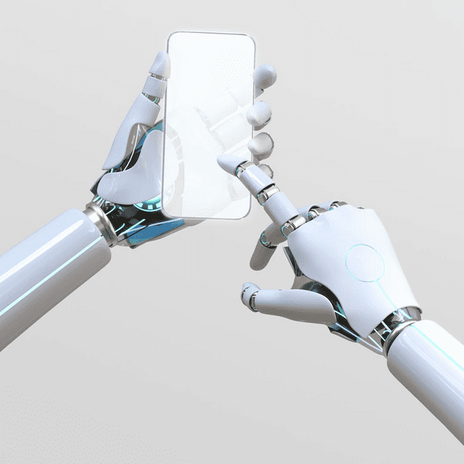
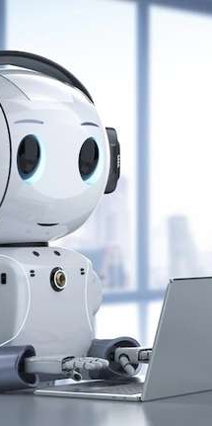
CONVERSATIONAL AI
Hello!
What type
of project
is it?
PUBLIC SCHOOL REGISTRATION PROCESS
It is a social welfare or community development project, aimed at improving the school registration process of Public Schools for immigrant children.
Public schools are often the primary option for immigrant families with a huge of benefits than private schools when adapting to a new culture.

Slide 4

What Problem? And how to solve by AI Project?
CONVERSATIONAL AI
PUBLIC SCHOOL REGISTRATION PROCESS
01
The school registration process for immigrants is currently not efficient or accessible, leading to difficulties and delays in enrolling immigrant children in schools.
02
To address this problem, the school registration process for immigrants needs to be streamlined and made more accessible. This could involve simplifying the registration process, providing more information and support for immigrant families, and ensuring that language barriers are addressed.
03
By improving the way to find out the school registration process by AI, immigrant children can have a better chance of succeeding in their education and integrating into their new communities.

Slide 5

CONVERSATIONAL AI
PUBLIC SCHOOL REGISTRATION PROCESS
Access to education is a fundamental right and ensuring that all children have equal access to educational opportunities is essential for their future success. Immigrant children face unique challenges when enrolling in schools, such as language barriers, lack of familiarity with the education system, and limited access to resources and support.
Why is this problem important?
If the school registration process is not efficient or accessible, it can lead to delays in enrolment, missed opportunities for learning, and difficulties integrating into their new communities. This can, in turn, impact their academic performance, social and emotional well-being, and prospects.
Improving the school registration process for immigrant children can help to ensure that they receive the education they need and deserve, regardless of their background or circumstances.
This can help to promote equal opportunities and social integration, as well as contribute to a more inclusive and prosperous society.
Notes:
slidesppt.net

Slide 6

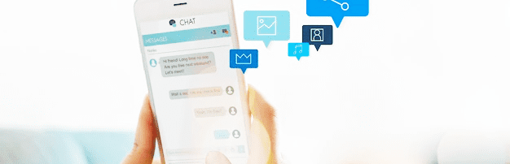
CONVERSATIONAL AI
PUBLIC SCHOOL REGISTRATION PROCESS
PERFORMING TASK
We are developing a chat bot for school registration process for immigrant children and their parents to get hassle free support and access to resources. Our task will be to research and analyze the needs of this specific user group, as well as the requirements for the school registration process. Based on this research, we will design and develop the chatbot using natural language processing techniques and user-centered design principles.
Notes:
slidesppt.net

Slide 7

CONVERSATIONAL AI
PUBLIC SCHOOL REGISTRATION PROCESS
EXPECTED SOLUTION
We expect the solution to turn out as a user-friendly and accessible chatbot that provides helpful and relevant information to immigrant families. The chatbot should be able to answer frequently asked questions about the registration process, provide guidance on necessary documentation and deadlines, and offer support for families who may have additional needs or questions. The chatbot should also be designed with the cultural background of the users in mind, ensuring that the language and tone of the chatbot are appropriate and respectful.
Notes:
slidesppt.net

Slide 8

CHATBOT IMPLEMENTATION PROCEDURE

Slide 9
CONVERSATIONAL AI
PUBLIC SCHOOL REGISTRATION PROCESS
Create an Azure ML Workspace
Create New Notebook in ML studio
Select an Azure Resource
Add URL in Manage Resource
Train & Test Knowledge Base
Test in Web Chat
1
3
5
7
9
11
Chatbot Implementation Procedure in Azure Portal
2
4
6
8
10
LAUNCHING CHATBOT
Create Compute Instance
Create Language Service Resource
Create New Language Project
Edit Knowledge Base by adding question
Create a Bot for Knowledge Base
Notes:
slidesppt.net

Slide 10
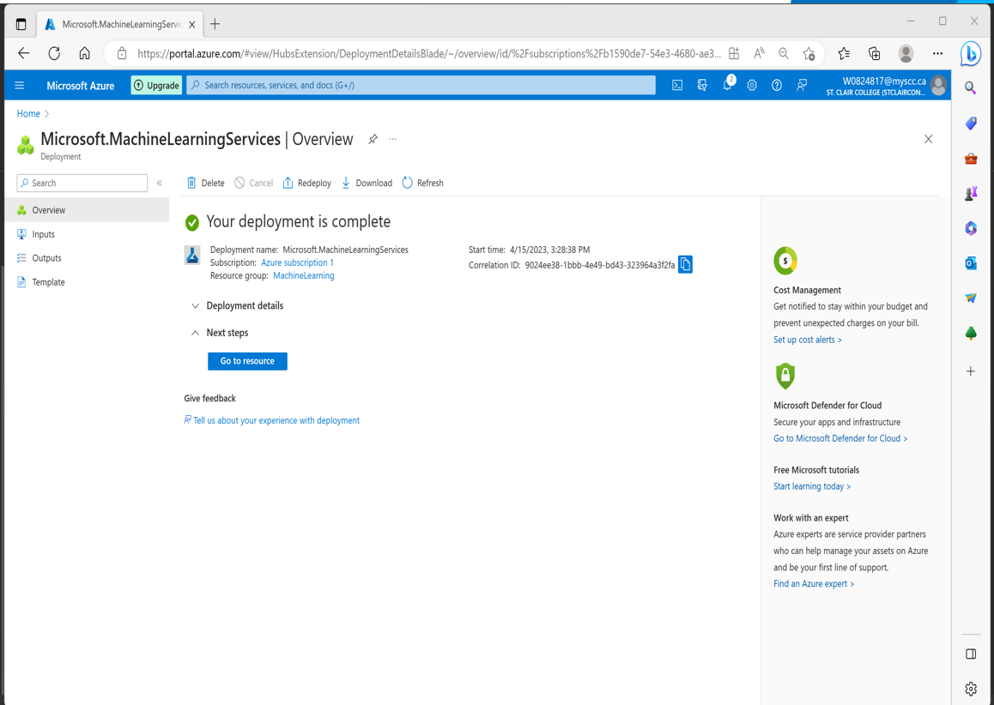
CONVERSATIONAL AI
PUBLIC SCHOOL REGISTRATION PROCESS
Step 1: Create an Azure ML Workspace
• Create or select a Resource Group with Unique name: MachineLearning
• Select nearest geographical Region: East US
• The remaining selection will automatically take the default values as per the workspace name and which will be created for our workspace
• Select Review + Create and then click on Create to create a workspace after validation
Passed.
• Workspace creation will take a few minutes and click on Go to Resource once the
deployment is completed.
Notes:
slidesppt.net

Slide 11
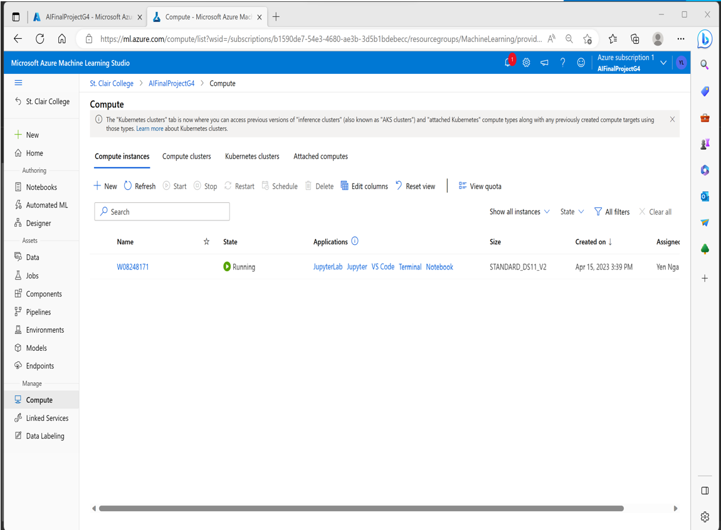
CONVERSATIONAL AI
PUBLIC SCHOOL REGISTRATION PROCESS
Step 2: Create Compute Instance
• Create Compute Instance by selecting Virtual Machine and type of Virtual Machine as CPU
Notes:
slidesppt.net

Slide 12
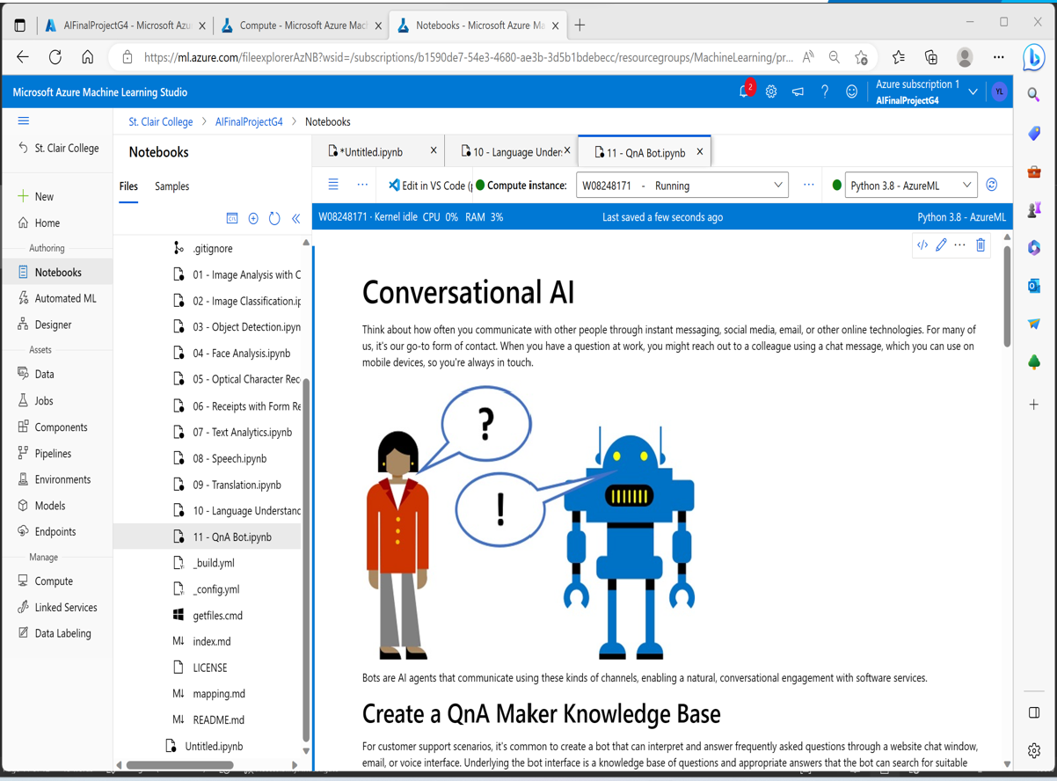
CONVERSATIONAL AI
PUBLIC SCHOOL REGISTRATION PROCESS
Step 3: Create New Notebook in Azure ML Studio
• Launch the Azure Machine Learning Studio and go to Notebooks and add File by
creating a new file.
• Create new python notebook file and add and run the GitHub URL to get the different
python notebooks from Azure machine learning fundamentals.
• Select the QnA Bot notebook for Conversional AI fundamental to create a chat bot.
Notes:
slidesppt.net

Slide 13
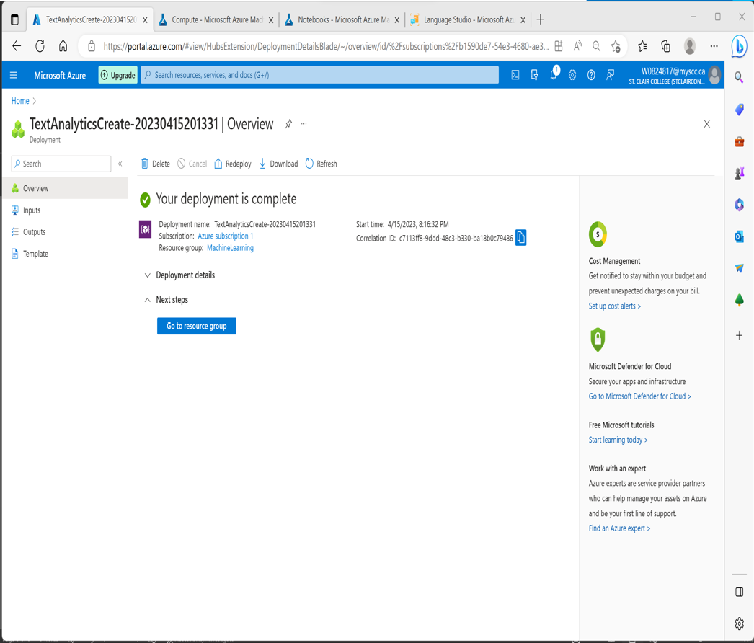
CONVERSATIONAL AI
PUBLIC SCHOOL REGISTRATION PROCESS
Step 4: Create Language Service Resource
• Go to Azure ML Home and Search for Language Service and click on Create to Language Service Resource.
• Go to Azure ML Home and Search for Language Service and click on Create to Language Service Resource.
• On the Create Language page, input the following Azure Subscription details, resource group, Instance details with geographical closest region, unique name for Language instance and pricing tier.
• Click on Review + Create by giving consent to Responsible AI notice.
• Click on Create once Validation Passed to create a Language Service which supports our custom question & answering knowledge base for Chat Bot.
Notes:
slidesppt.net

Slide 14
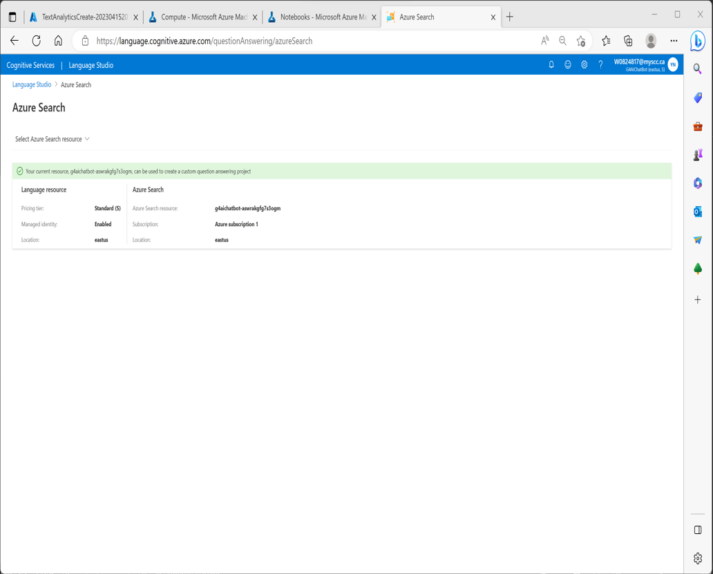
CONVERSATIONAL AI
PUBLIC SCHOOL REGISTRATION PROCESS
Step 5: Select an Azure Resource
• Open the Language Studio portal at https://language.azure.com in a new browser tab
by signing Microsoft account with associated Azure subscription.
• Select the following settings to choose language resource such as: Azure directory, Azure
Subscription and Language Resource type and Name which is already created previously
in Step 4 as below which is used for Custom Question and answering knowledge base
Project.
Notes:
slidesppt.net

Slide 15
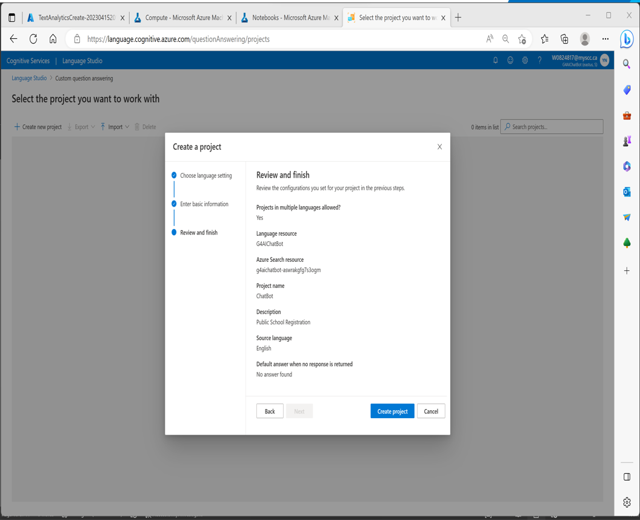
CONVERSATIONAL AI
PUBLIC SCHOOL REGISTRATION PROCESS
Step 6: Create New Language Project
• Click on the Create new project and select custom question answering from the top of Language Studio portal.
• Choose below selection for creating new project for our resource as I want to select the language when I create a project in this resource.
• Enter the basic information for the knowledge base project with Unique Name, Description, Source language and Default answer when no answer is identified from the knowledge base is returned.
Notes:
slidesppt.net

Slide 16
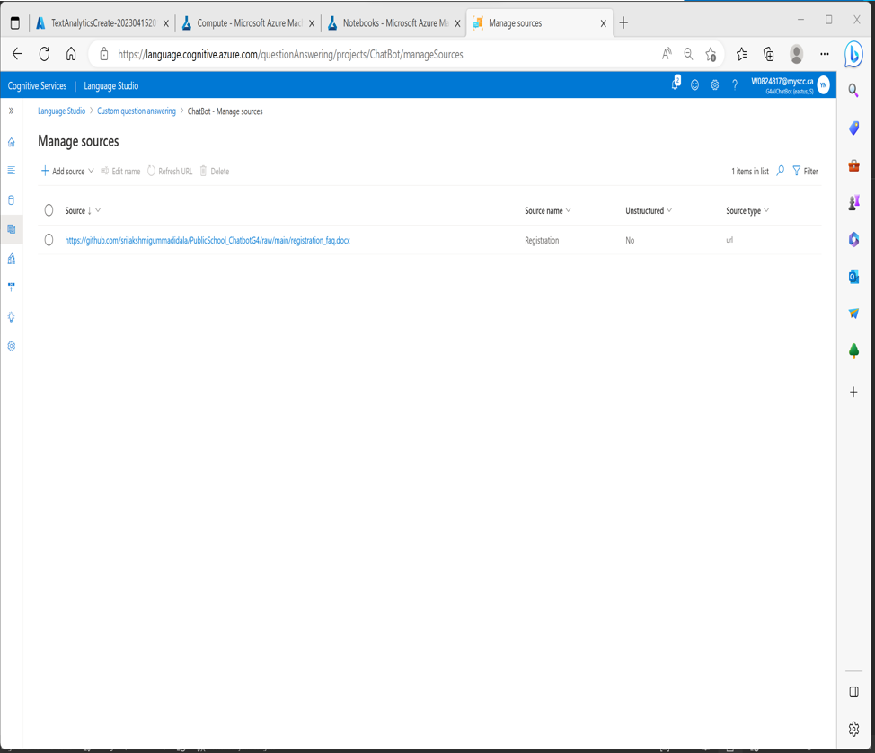
CONVERSATIONAL AI
PUBLIC SCHOOL REGISTRATION PROCESS
Step 7: Add URL in Manage Resource
• Once a project is created, we can automatically direct to Manage Sources page, click on + Add source and select the URLs to give Knowledge base inputs via following GitHub URL.
• Click on add URL and give the URL name and URL address as below with classify file structure as Auto-detect option.
• URL:
https://github.com/srilakshmigummadidala/PublicSchool_ChatbotG4/raw/main/registratio
n_faq.docx
Notes:
slidesppt.net

Slide 17
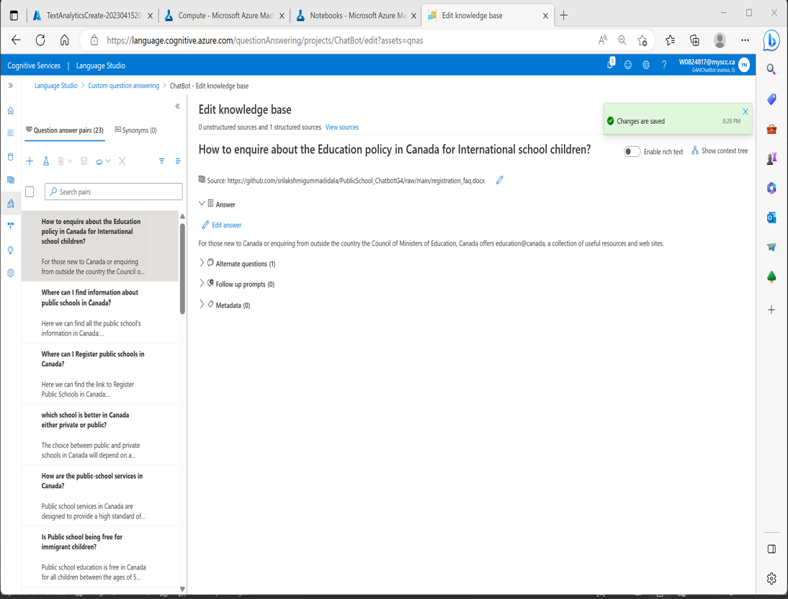
CONVERSATIONAL AI
PUBLIC SCHOOL REGISTRATION PROCESS
Step 8: Edit Knowledge Base by adding question
• Edit the knowledge base from the left-hand side panel and add question pair.
• Add Question Hi and Answer Hello! With the source of knowledge base URL as given earlier and save the changes.
Notes:
slidesppt.net

Slide 18
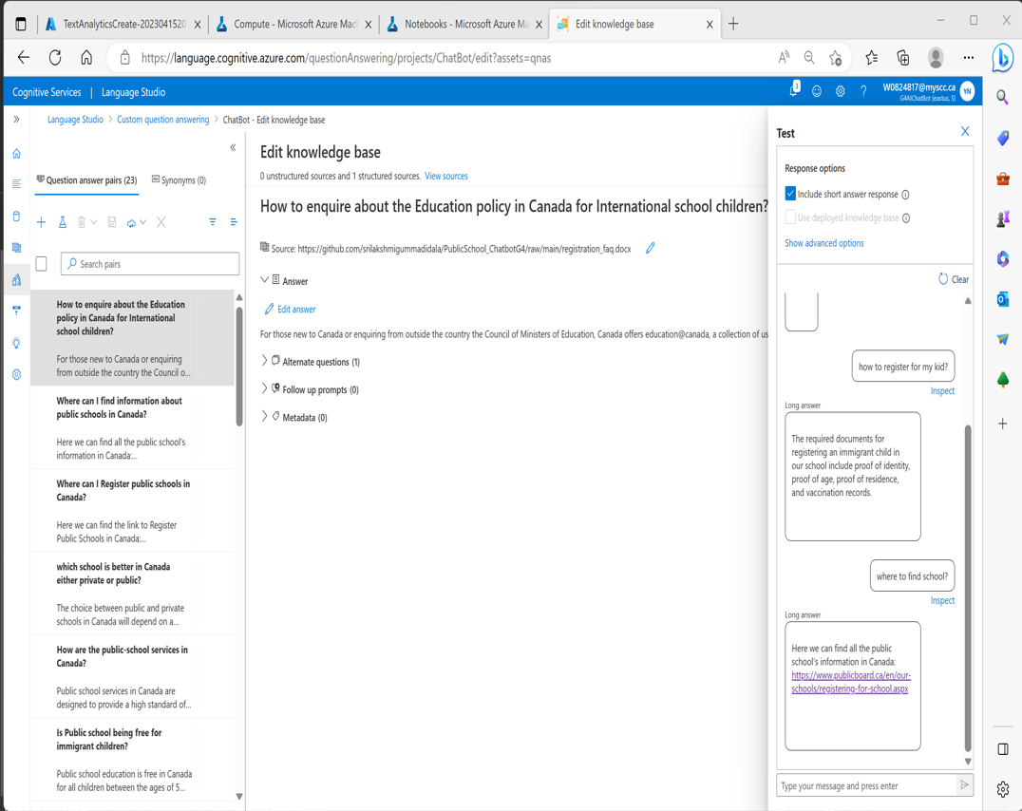
CONVERSATIONAL AI
PUBLIC SCHOOL REGISTRATION PROCESS
Step 9: Train and test Knowledge Base
• At the top of page, click on the Test to test our knowledge base.
• In the test panel, at the bottom enter the message Hi, the response from the bot Hello!
should return.
• Test with some other questions in the test pane, the appropriate response from knowledge base FAQ should be returned.
Notes:
slidesppt.net

Slide 19
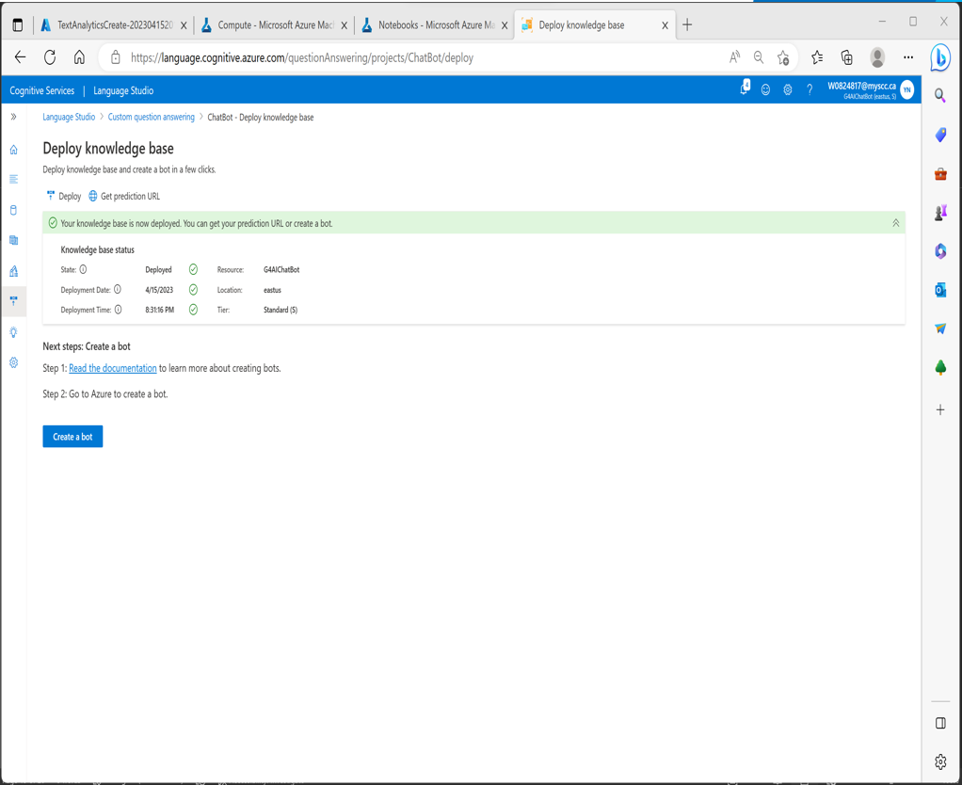
CONVERSATIONAL AI
PUBLIC SCHOOL REGISTRATION PROCESS
Step 10: Create a Bot for Knowledge Base
• The knowledge base provides a back-end service that client applications can use to
answer questions through some sort of user interface.
• To make the knowledge base available to a bot, we must publish it as a service that can be
accessed over HTTP.
• At the top left of the language studio, click on Deploy Knowledge base which we created
and tested in the previous steps.
• Once the service is deployed, click on Create a bot as next steps which eventually opens a
new Azure browser tab to create a Web app bot with our Azure subscription.
Notes:
slidesppt.net

Slide 20
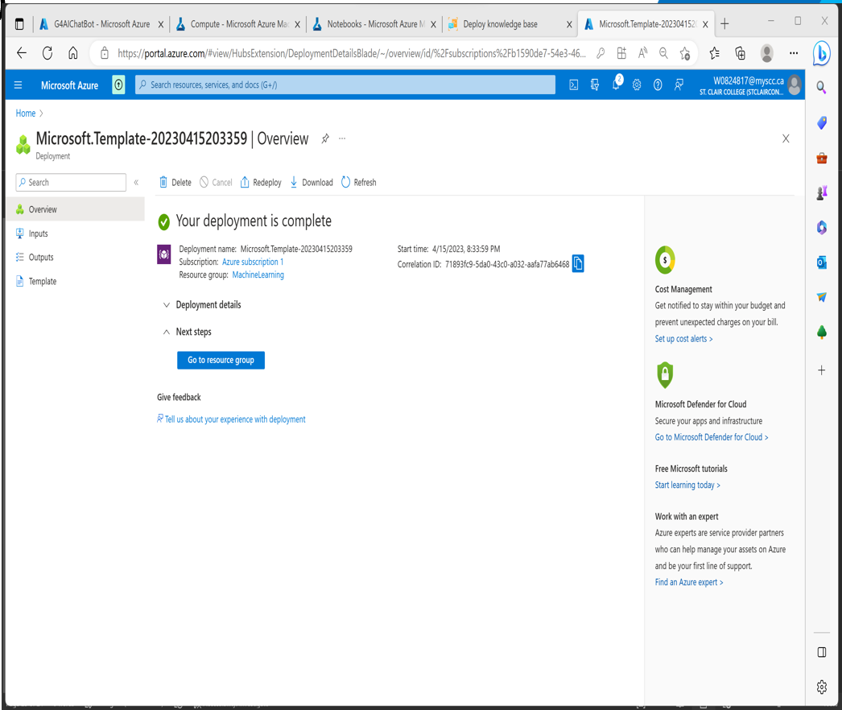
CONVERSATIONAL AI
PUBLIC SCHOOL REGISTRATION PROCESS
Step 10: Create a Bot for Knowledge Base (continue)
• Add the following settings with the project details (Resource group, Region & Azure Bot which are pre-populated, Pricing which is standard tier & Microsoft App ID creation type, choose the Create new user – assigned managed identity).
• To continue updating the settings, go to Azure portal, on the home page, click on Resource Groups and locate the resource group which we created for our language resource.
• Select language resource and navigate to its left-hand menu. Then select Keys and Endpoint under Resource Management. Copy the key1 and update the key for Language Resource Key.
• Give the Language project name and check the other inputs which are pre-populated as per the previous steps.
Notes:
slidesppt.net

Slide 21
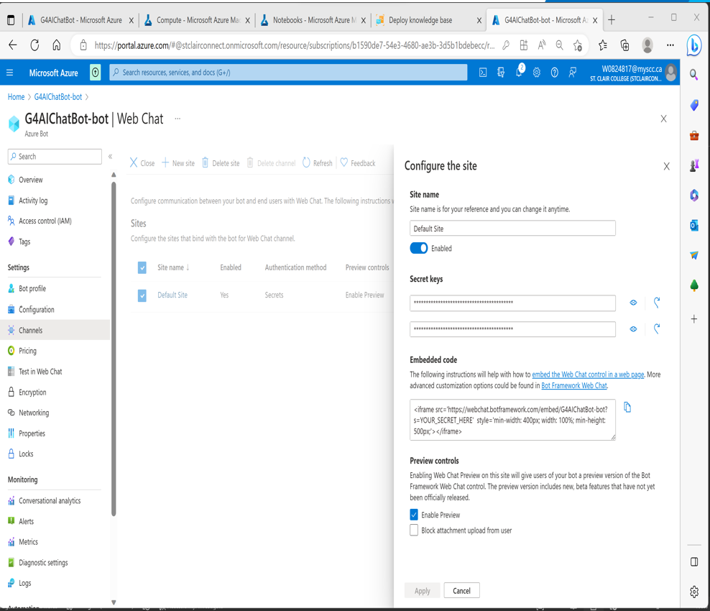
CONVERSATIONAL AI
PUBLIC SCHOOL REGISTRATION PROCESS
Step 11: Test in Web Chat
• After deployment, test a bot in Web chat by navigating to Azure machine resource group & select the Azure bot which is created previously & in the left side panel, under settings select Test in Web Chat option to test our above created bot.
• Go to Channels and select the channel as Web Chat.
• Click on Edit, which opens the settings page where we can get the embed code to embed our bot in a web page.
• To embed a bot, we need HTML embed code & secret key which is generated for our Bot.
Notes:
slidesppt.net

Slide 22
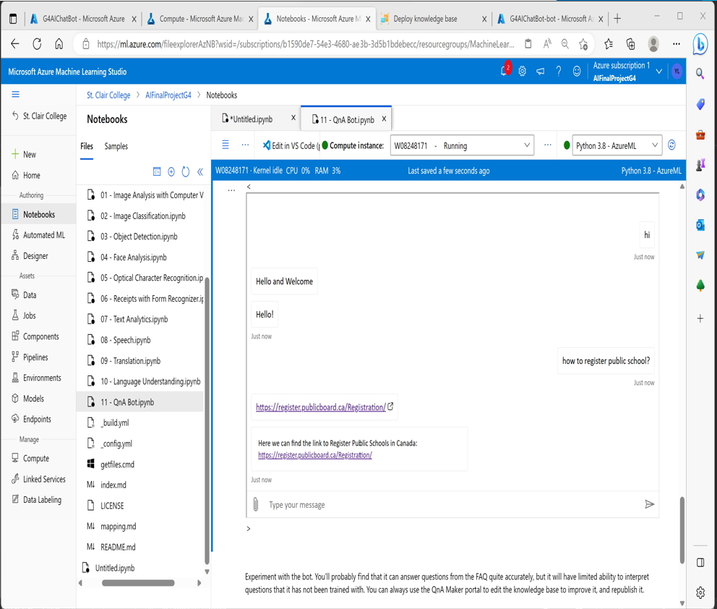
CONVERSATIONAL AI
PUBLIC SCHOOL REGISTRATION PROCESS
Step 11: Test in Web Chat (continue)
• Copy the embedded code and paste it into QnA python notebook which is opened in Step3 by replacing the default information YOUR_SECRET_HERE to secret key from below settings page.
• After adding the embedded code along with secret key, run the code in QnA python notebook to render HTML chat interface.
• From the HTML chat interface, test the bot by giving a Question, such as How to Register public school in Canada as per the knowledge base created.
Notes:
slidesppt.net

Slide 23

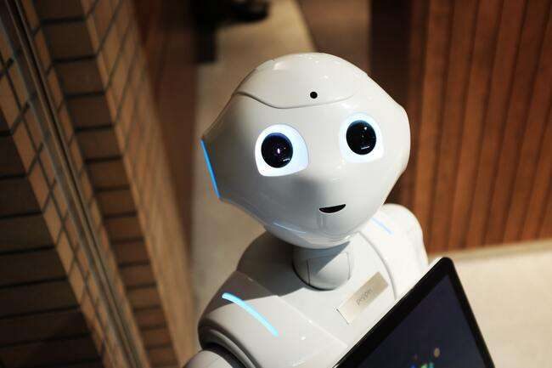

CONVERSATIONAL AI
PUBLIC SCHOOL REGISTRATION PROCESS
Challenges In Completing Project
Limited understanding of user needs posed a challenge as we, as immigrant graduate students, lacked familiarity with the specific needs and concerns of the target audience, which are families with children under 18 who require free public-school registration. Our own experiences with college-level registration processes did not directly translate to this context, making it difficult to design and develop a relevant and useful chatbot.

Slide 24

CONVERSATIONAL AI
PUBLIC SCHOOL REGISTRATION PROCESS
To overcome above challenge, we conducted extensive research by checking through immigrant students who have children and experienced difficulties during their registration process free public schools. This helped us to build a comprehensive knowledge base to design a chat bot that could help immigrant families with appropriate resources and support. Additionally, we thoroughly researched various school websites and their FAQs to gather relevant information that parents may require during the registration process. This information can be automated and provided as a hassle-free response from the AI chatbot.
15%
20%
60%
Solutions
Notes:
slidesppt.net

Slide 25
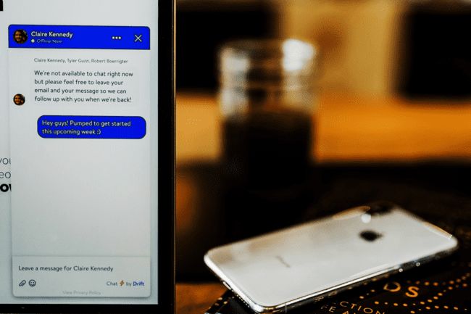

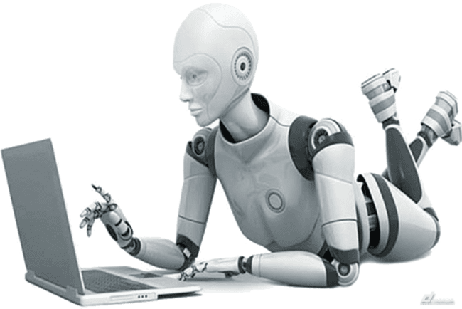
RECOMMENDATIONS
Addressing Language Barrier Constraints
Develop a chatbot to provide real-time support
Leverage data analytics to identify areas for improvement
Provide training for school staff
PUBLIC SCHOOL REGISTRATION PROCESS
CONVERSATIONAL AI
Notes:
slidesppt.net

Slide 26
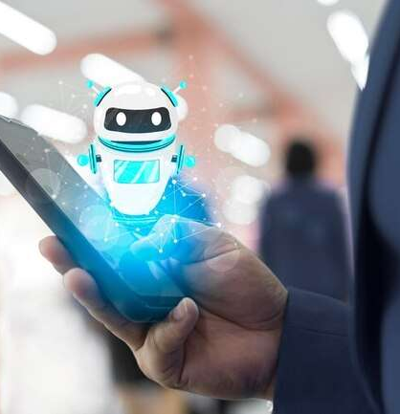
CONVERSATIONAL AI
PUBLIC SCHOOL REGISTRATION PROCESS
THANK YOU
GROUP 4 – DAB 106 - 004

